Slide 1
Point Pattern Matching
Pattern Recognition 2015/2016
Marc van Kreveld

Slide 2
Point pattern matching
Matching a point set to a model
Matching parts of a point set to a model
RANSAC
Hough transform
Matching two point patterns to each other
exact: translation, scaling, rotation
with imprecision (noise)
with outliers

Slide 3
Matching a point set to a model
Examples of models:
circle (boundary)
disk (with interior)
line (in 2D or 3D)
plane (in 3D)
rectangle (in 2D or 3D)
more complex shape (template)

Slide 4
Matching a point set to a circle
Need a measure of fit that can be optimized over all possible circles
Min max distance (bottleneck) from all points to circle
Min sum distance (min sum)
Min sum distance squared
Min max is easiest to compute, but is also most sensitive to outliers

Slide 5
Matching a point set to a circle
Need a measure of fit that can be optimized over all possible circles
Min max distance (bottleneck) from all points to circle
Min sum distance (min sum)
Min sum distance squared
Min max is easiest to compute, but is also most sensitive to outliers

Slide 6
The rectangle problem
Given a set P of points, “is” it a rectangle?
yes
no
no

Slide 7
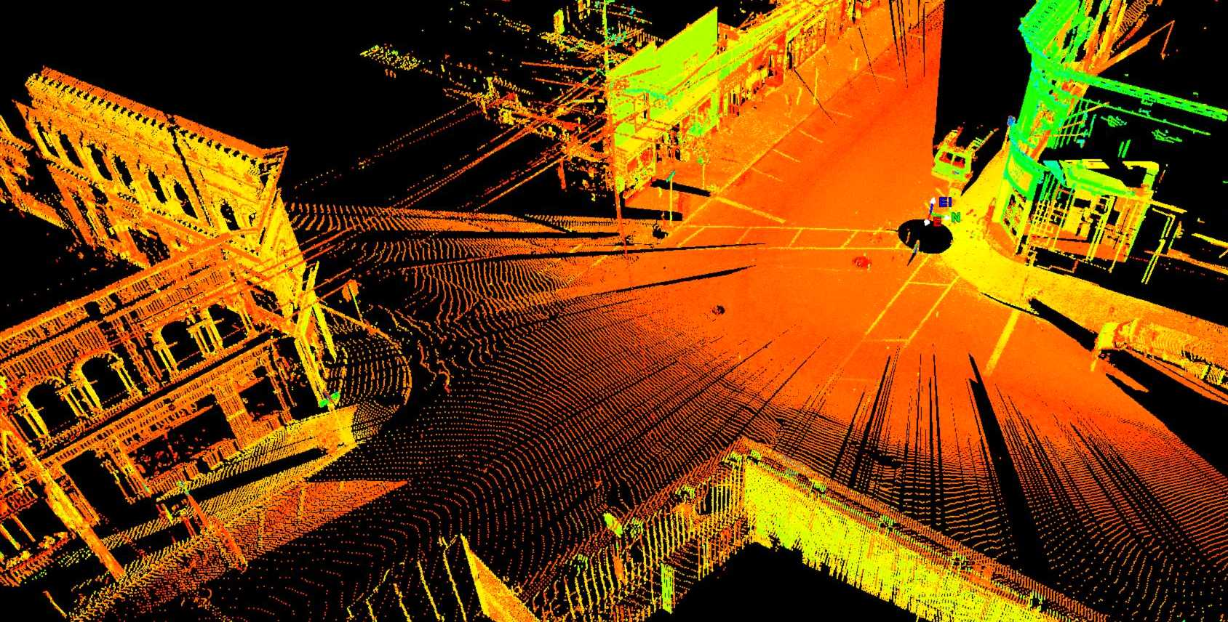
The rectangle problem
It appears that about 30% of the facets to be seen in a LiDAR point cloud of an urban scene can be considered a rectangle

Slide 8
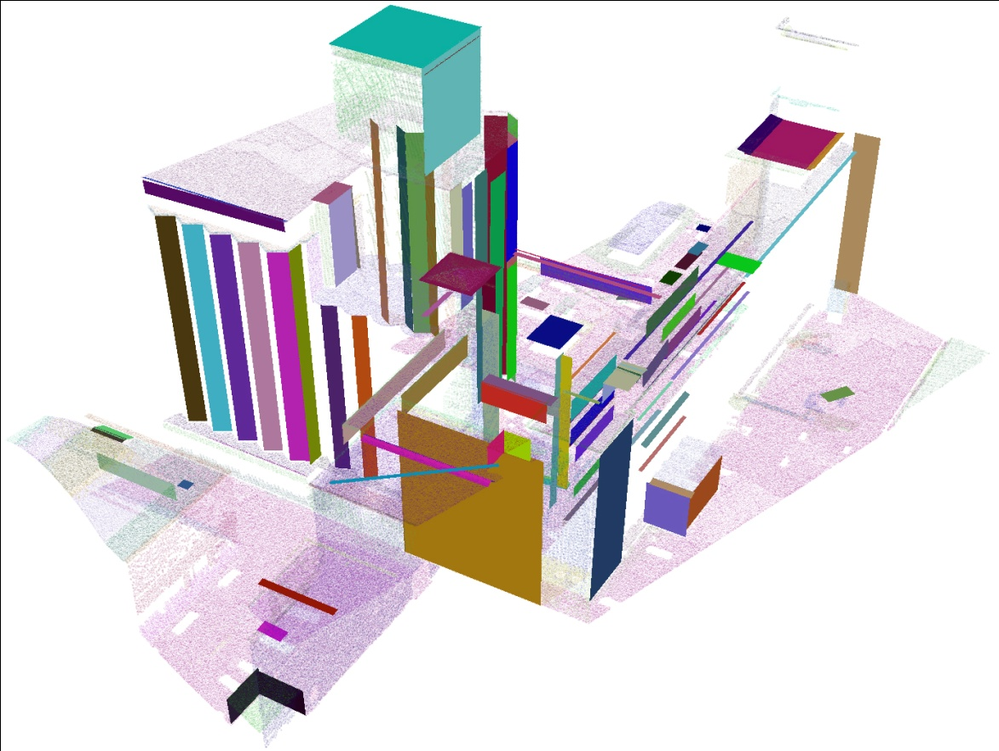

Slide 9
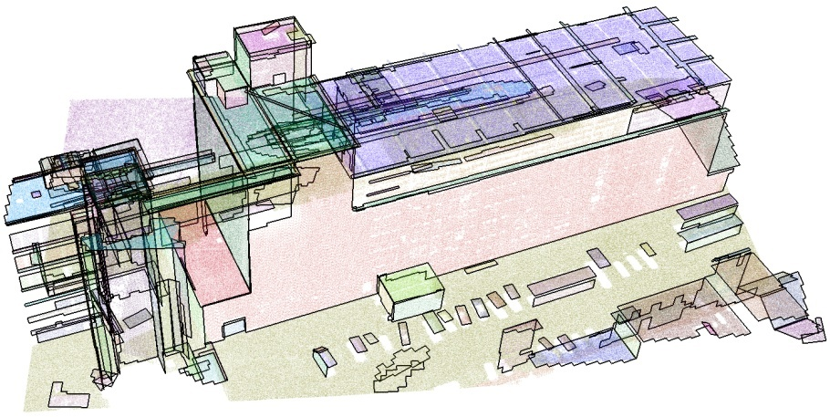

Slide 10
The rectangle problem
Two conditions:
It should not have extra stuff (outside)
It should not have missing stuff (inside)

Slide 11
The rectangle problem
Formalization of the two conditions:
no extra stuff outside → no point outside at all
no missing stuff inside → take the union of radius-r disks centered on the points, and require that this union contains the rectangle completely r is a parameter related to the assumed density of the points

Slide 12
The rectangle problem
If we know the orientation, we can determine a tightly fitting rectangle with that orientation uniquely (if any rectangle works, a tightly fitting one will) → Algorithmic idea: rotate a tightly fitting rectangle around the point set and test the two conditions

Slide 13
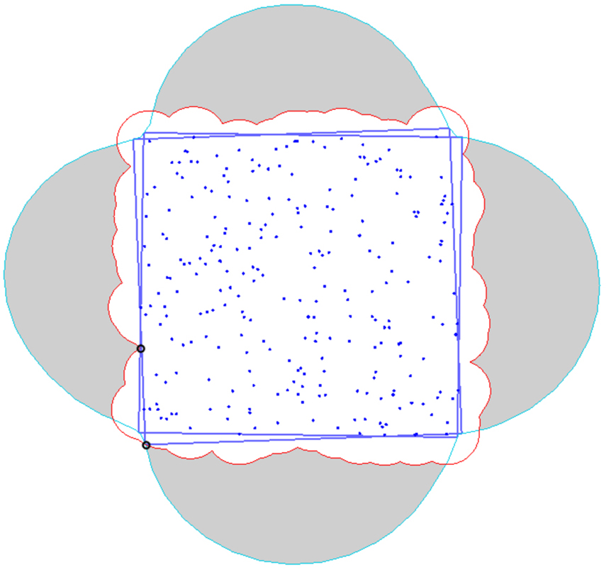
The rectangle problem
union of the r-disks centered at points
trace of the corners of the tightly fitting rectangle

Slide 14
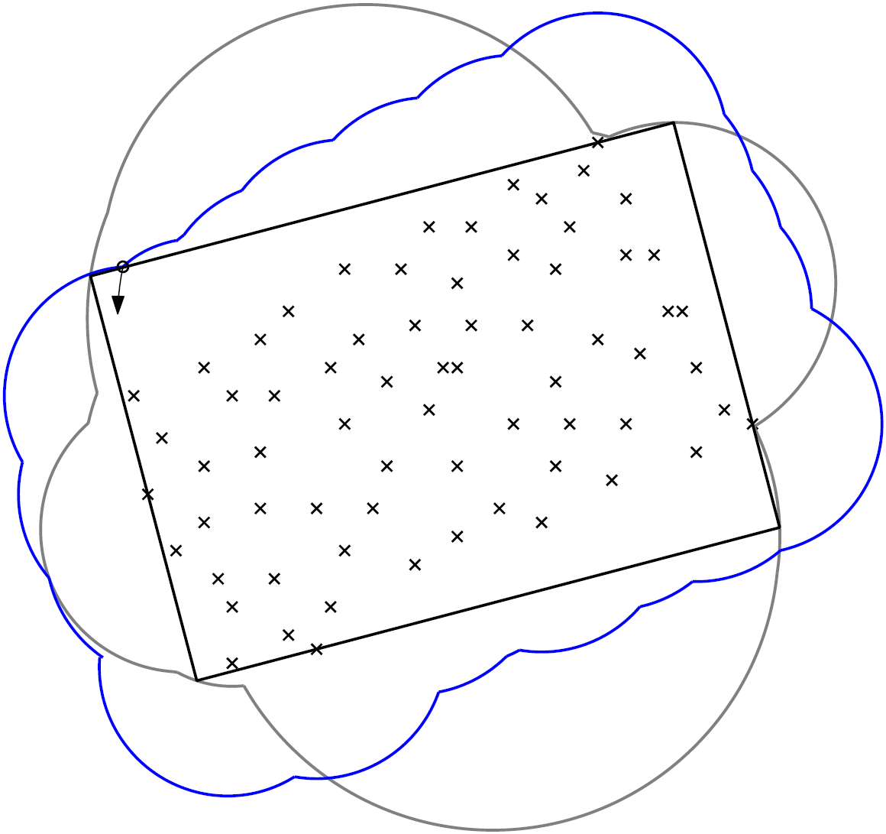
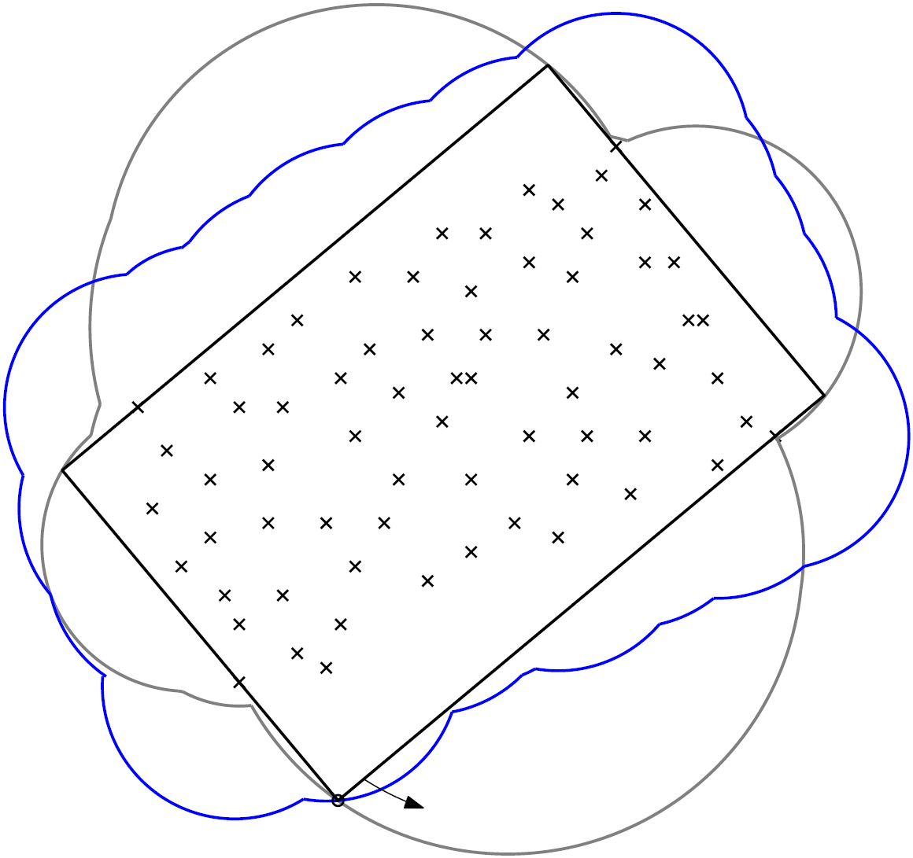
The rectangle problem
The algorithm can be made to run in O(n log n) time, when there are n points

Slide 15
The disk problem
Since a disk is rotation-invariant, is the equivalent problem easier for a disk?
No, there is no clear most tight fit

Slide 16
The disk problem
Algorithmic approach:
Compute the union of the r-disks centered at points
Take the vertices of this union and make them “red” points → there is a disk with all “blue” points inside and no extra stuff if and only if there is a red-blue separating circle (under a few reasonable assumptions)
Red-blue point separation by a circle can be formulated as a 3D linear programming problem

Slide 17
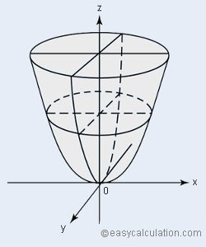
The disk problem
Red-blue point separation by a circle
Map every point (x, y) into 3D to the point (x, y, x² + y²)
Search for a plane with all red 3D points above and all blue 3D points below it; this is the dual formulation of standard linear programming

Slide 18
The disk problem
Red-blue point separation by a circle
Geometrically, all points are put on the unit paraboloid U: z = x² + y²
Every plane in 3D:
Does not intersect U
is vertical and intersects U in a parabola
is not vertical and intersects U in a shape whose vertical projection onto the xy-plane is a circle

Slide 19
The disk problem
Computing a disk with all n points inside and no empty areas …
It is known that the union of n unit disks can be computed in O(n log n) time and has O(n) vertices
It is known that linear programming in 3D with linearly many constraints can be solved in linear time
… can be solved in O(n log n) time

Slide 20
Matching parts of a point set to a model
Two popular methods: RANSAC and the Hough transform
Used for 3D reconstruction, in particular, to find many points close to a plane in 3D, yielding facets of buildings

Slide 21
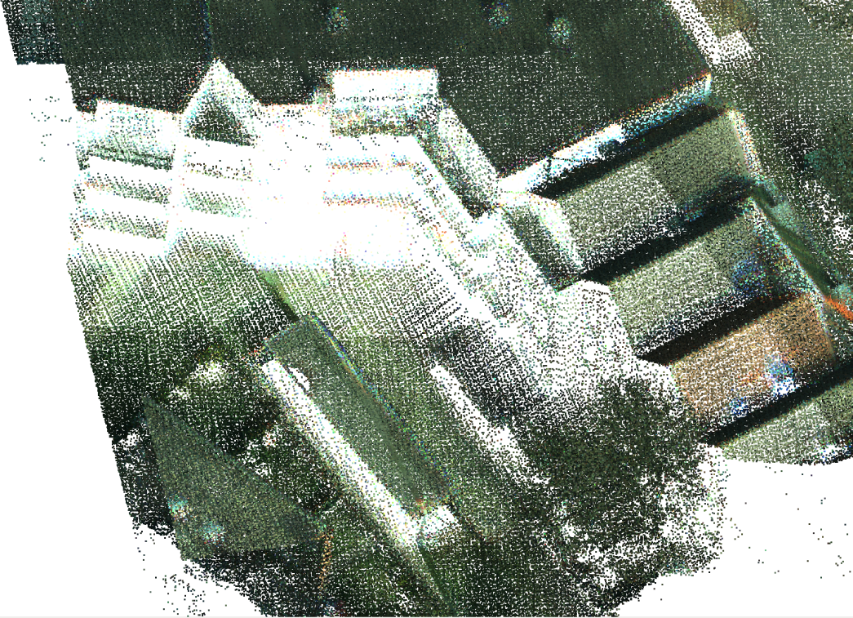
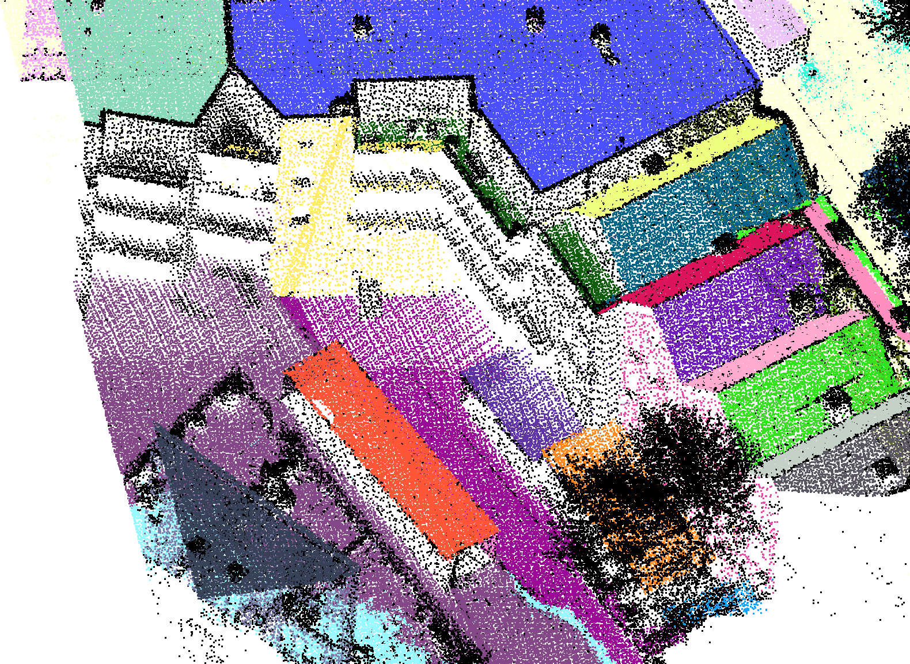
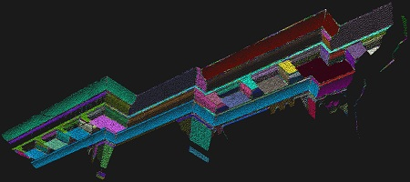
Points clustered by planes

Slide 22
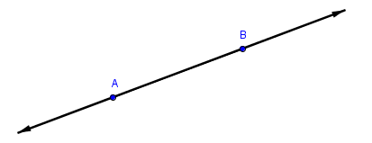
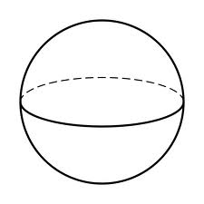
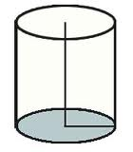
RANSAC
RANdom SAmple Consensus: method that can be used to detect planes (and other shapes) in point sets
randomized
assumes a model defined by few points
line: defined by two points
plane: defined by three points
sphere: defined by four points
vertical cylinder: defined by three points

Slide 23
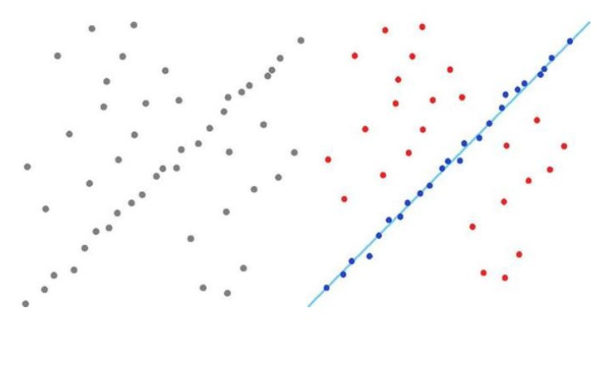
RANSAC
Simplest case: 2D point set, we want to find a line with most points on (or near to) it
points on/near this line are called inliers, they support the line
other points are outliers, they do not support the line

Slide 24
RANSAC
Choose a threshold distance d
For #iterations do
Choose 2 points, make line L
For each point q in P, test if q lies within distance d from L If yes, increase the support of L by 1
If L has higher support than the highest-support line found so far, remember L and its support
Return L as the line with most points near it

Slide 25
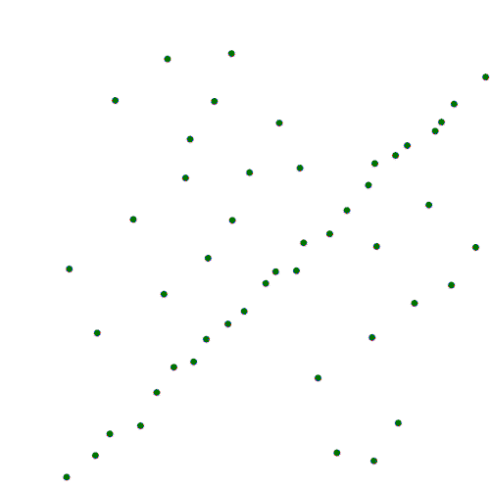
RANSAC

Slide 26
RANSAC
For testing whether a point q supports a line L, we do not actually compute the distance from q to L
Instead, we generate two lines at distance d from L
Then we test for each point whether it lies below the upper and above the lower line

Slide 27
RANSAC
How large should the threshold distance d be?
How many iterations should we do to have a high probability of finding the line with highest support? → the threshold distance is related to the measurement error (~5 cm) and the flatness of the surface → the number of iterations depends on the inlier-outlier ratio and with how much probability we want to find the best line

Slide 28
RANSAC, iterations
Suppose we want to have 95% probability, p=0.95, of finding the best line
Suppose there are k points on the line (inliers) and n points in total
Then the probability of choosing 2 points on the line is (k/n)²
The probability of never selecting 2 points on the line in r iterations is ( 1 – (k/n)² )^{r}
The probability of finding the line in r iterations is 1 – ( 1 – (k/n)² )^{r}

Slide 29
RANSAC, iterations
So we want 1 – ( 1 – (k/n)² )^{r} > p ( 1 – (k/n)² )^{r} < 1 – p log ( 1 – (k/n)² )^{r} < log (1 – p) r log ( 1 – (k/n)² ) < log (1 – p) r > log (1 – p) / log ( 1 – (k/n)² )
Notes:
The inequality changes from < to > because the log() by which we divide on both sides is a negative number.

Slide 30
RANSAC, iterations
Examples:
if 10% of the points lie on the line and we want to find it with 95% certainty, we need nearly 300 iterations
if 5% of the points lie on the line and we want to find it with 95% certainty, we need nearly 1200 iterations
if 10% of the points lie on the line and we want to find it with 90% certainty, we need nearly 230 iterations

Slide 31
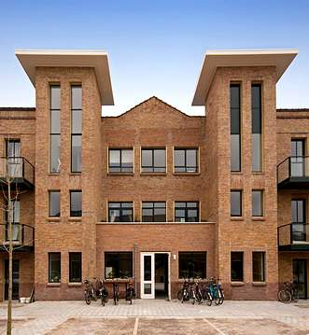
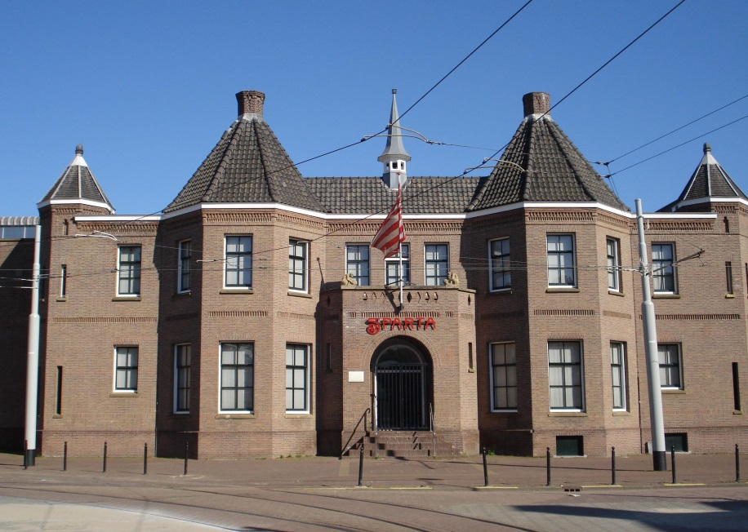
Improving RANSAC
Sample points not too far apart
Use surface normals of points to test if a sample makes sense, and when deciding on support
Collect points in a plane if they form a “connected component”

Slide 32
Improving RANSAC
For facades and roofs in cities, sample triples of points no further than 50 m apart → increases probability finding planes; fewer iterations
Do not sample too close either: inaccuracy of points in the same plane will lead to a wrong angle / normal

Slide 33
Improving RANSAC
For each point we can estimate a surface normal using, say, 12 nearest neighbors
Use Principal Component Analysis and let the normal be the third component (eigenvector with smallest eigenvalue)
or, fit a plane through these 12 points plus the point itself, and use the normal of that plane

Slide 34
Improving RANSAC
When performing RANSAC and we know normals:
delete a sample of three points immediately if their normals deviate much from the plane they define
let only points with correct normals support a tested plane (say, angle deviation at most 20 degrees), on top of the requirement of being close to the plane

Slide 35
Improving RANSAC
Four nearest neighbors, point itself included

Slide 36
Improving RANSAC
Four nearest neighbors, point itself included
The brown point supports the line (correct normal) but the green point does not (wrong normal)

Slide 37
Improving RANSAC
Collect points in a plane if they form a “connected component”
on the same plane

Slide 38
Iterated RANSAC
After finding the plane with the most points, remove the points from the set and remember them as a cluster
Then continue and find more planes, until no plane seems to have sufficient support
Points not in clusters are black Why are the outlines of planar regions black?
Notes:
Near the outlines, the estimated normals deviate from the plane normal because the 12 nearest neighbors come from different planes, so these points are not considered inliers.

Slide 39
Iterated RANSAC
The remaining points are
vegetation
curved surfaces (cars, domes)
traffic signs, lamp posts, mailboxes, garbage bins, bicycles, drainage pipes, …
points on planes whose normal was incorrect (possibly, close to corners)
points on very small or largely occluded planes
points inside buildings measured through windows
These points may still help for reconstruction

Slide 40
Hough transform
The Hough transform is an alternative to RANSAC and can also give a plane close to many points
It discretizes the set of all lines by a grid; points give a count to all grid cells whose lines come near that point
intercept
1
1
1
1
1
1
1
slope

Slide 41
Hough transform
The middle of the cell with the highest number gives slope and intercept of a line with many points close by
intercept
1
1
1
1
1
1
1
slope

Slide 42
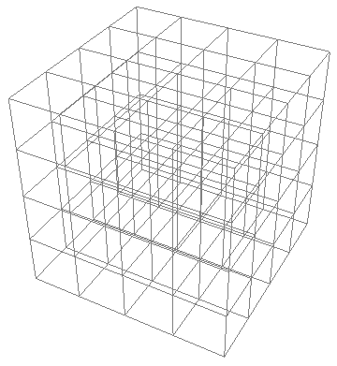
Hough transform
In 3D, the grid is also 3-dimensional (and may take up a lot of storage space)
intercept (with z-axis)
slope 2
slope 1

Slide 43
Matching two point patterns, exact
Matching point sets A and B exactly
under translation
under translation and scaling
under translation and rotation
under translation, scaling and rotation

Slide 44
Matching two point patterns, exact
If two point sets match exactly, then their centers of mass coincide → translate A so that its center of mass lies at the origin, and do the same for B
For the translation-only case, we just need to check whether all points of A and B lie at the same locations
O(n log n) time

Slide 45
Matching two point patterns, exact
The case translation and scaling:
the centers of mass should coincide
the points of A and B furthest from the centers of mass should be equally far away
→
Translate A and B so that their centers of mass lie at the origin
Scale B so that the point furthest from the origin lies as far away as in A
Check if the point sets coincide
O(n log n) time

Slide 46
Matching two point patterns, exact
The case translation, scaling, and rotation in the plane:
After the translation and scaling parts, if the furthest point from the origin in A and in B are unique, then rotate to make them coincide, and then test the point sets
If the furthest points are not unique, there may be more rotations to test (if there are different numbers of furthest points in A and B, then no exact match can exist)
o
o

Slide 47
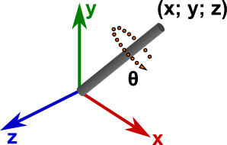
Matching two point patterns, exact
The case translation, scaling, and rotation in 3D:
After the translation and scaling parts, if the furthest point from the origin in A and in B are unique, then make them coincide
Assume b is the furthest point in B. Then we can still rotate in 3D around the axis ob to make the point sets coincide. Choose the point furthest from ob in B and the one furthest from the corresponding axis in A, and make them coincide

Slide 48
Matching two point patterns, exact
The case translation, scaling, and rotation: In practice, the two point sets will never coincide exactly when rotation is involved, due to rounding in storage and computation when rotating

Slide 49
Matching two point patterns
When there is imprecision (noise, geometric deviations), we want to match each point of A to within a neighborhood (ε-disk) of a unique point in B with a transformation
A
B

Slide 50
Matching two point patterns
Note that this is not the same as finding a transformation so that the Hausdorff distance from A to B is at most the imprecision value ε
A
B

Slide 51
Matching two point patterns
Within this class of problems, deciding whether a transformation T exists that maps A close to B:
The properties for the exact case no longer hold
Translation-only is easier than the rest (obviously)
Using squares for an ε-neighborhood is easier than using ε-disks
Hausdorff (many-to-one) or one-to-one-matching may be computationally easier, depending on the precise problem setting

Slide 52
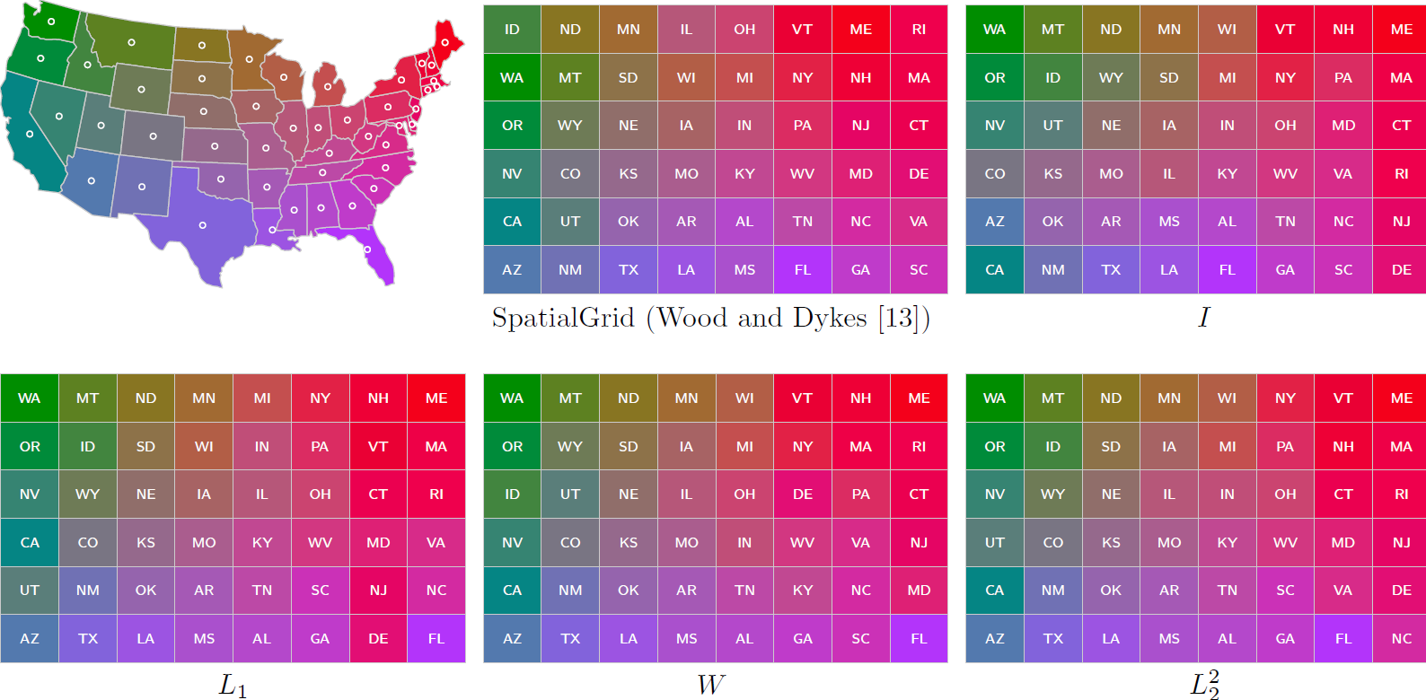
Example application: grid maps
Taken from: D. Eppstein, M. van Kreveld, B. Speckmann, and F. Staals:
Improved Grid Map Layout by Point Set Matching. International Journal of Computational Geometry and Applications 25(2), 101-122 (2015)

Slide 53
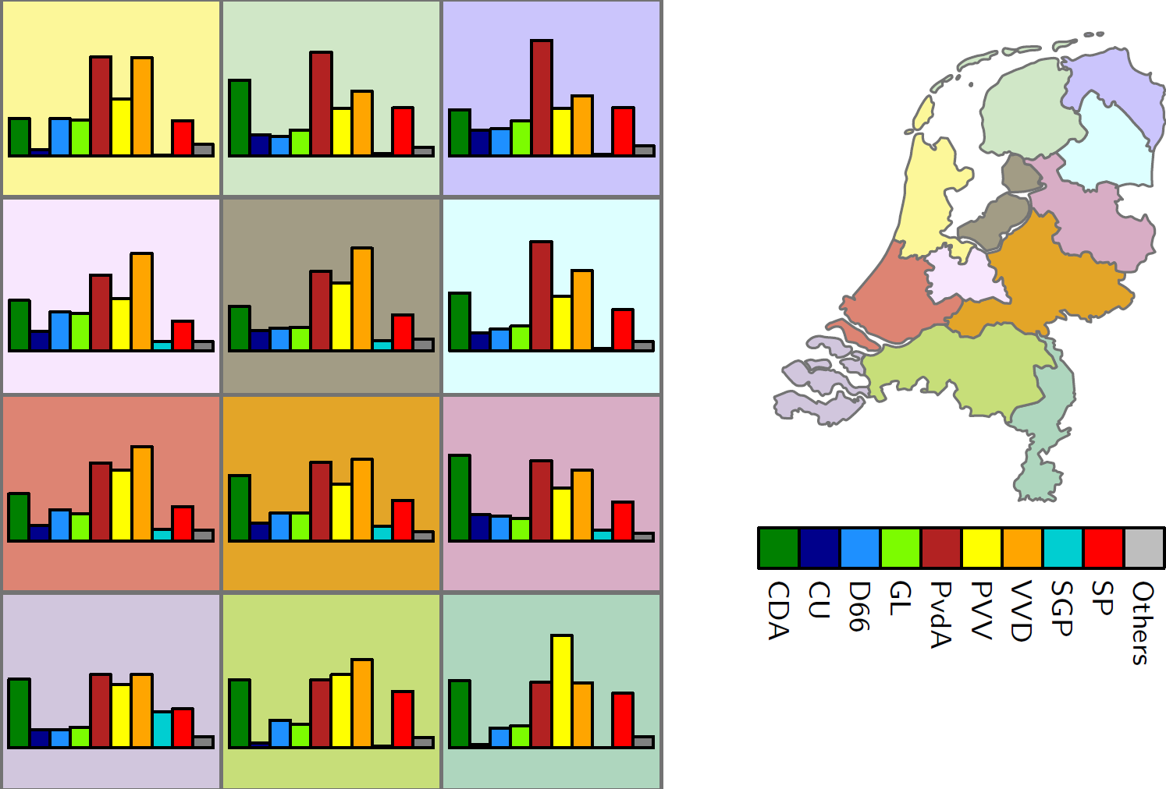
Example application: grid maps

Slide 54
Grid maps
Use the centroids of the regions (48 United States) and the centers of a 6x8 grid as point sets A and B
Find a one-to-one matching between them:
no transformation I, L₁-distances
translation only, L₁-distances
translation only, L₂²-distances
Using no transformation, I, just takes a reasonable fixed placement and scaling of A amidst B (same center of mass, same bounding box, …)

Slide 55
Grid maps
All nxn distances are used between a point in A and a point in B, and a minimum weight matching is used
with I, this is it
with translation only, L₁-distances or L₂²-distances, we optimize over all possible translations (i.e., we determine the translation that minimizes the weight of the matching)

Slide 56
Grid maps

Slide 57
Grid maps
Computation for I is O(n² log³ n) time
L₁-distances minimum matching is faster than general matching
Computation for translation and L₁ is O(n⁶ log³ n) time
It can be shown that there is an optimum with a horizontal and a vertical alignment of pairs from A and B
Computation for translation and L₂² is O(n³) time
Translation is trivial because it is known that the centers of mass must coincide to minimize the matching, using this measure
The rest is a minimum weight matching problem in a graph with n vertices and n² edges

Slide 58
Grid maps
Evaluation of the results by:
sum of all 48 L₁ distances
sum of all 48 L₂ distances
sum of all 48 L₂² distances
number of relative orientations between pairs of states that are preserved (California is southwest of Colorado, etc.)
number of adjacencies between states that also appear in the grid

Slide 59
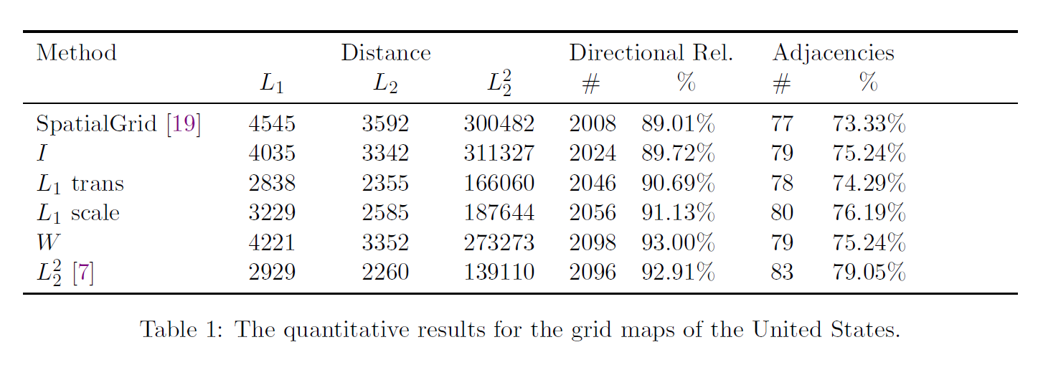
Grid maps

Slide 60
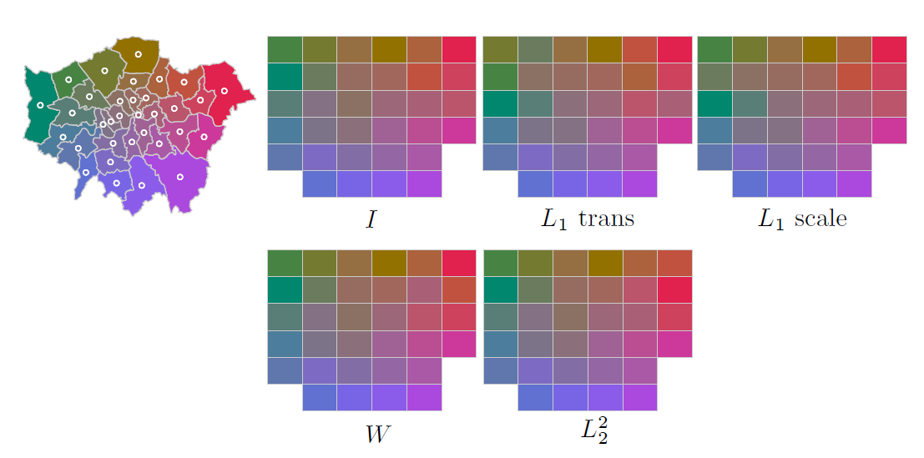
Grid maps
What if the number of regions and the grid size do not have the same number of cells (points)? E.g., the 33 boroughs of London on a 6x6 grid

Slide 61
Grid maps
Option 1: choose a suitable subgrid beforehand
Option 2: let the matching algorithm decide which cells of the grid to use

Slide 62
Outliers
Not an issue in RANSAC
Possibly an issue for the rectangle problem and the circle problem
The point set is not a rectangle, but if one point may be ignored as an outlier, then it is

Slide 63
The rectangle problem with outliers
Suppose we allow one outlier
Brute force approach: try every point as the outlier and run the existing algorithm on the rest
Running time becomes n x O(n log n) = O(n² log n)
Generalization to k outliers gives (n choose k) times O(n log n) = O(n^{k+1} log n) time

Slide 64
The rectangle problem with outliers
Observe: one outlier must lie on the convex hull (not necessarily true for 2 outliers), we need to try these points only as the outlier

Slide 65
The rectangle problem with outliers
We can also run the algorithm where one side of the rectangle ignores one point of the set; such an algorithm still runs in O(n log n) time

Slide 66
The rectangle problem with outliers
We can also run the algorithm where one side of the rectangle ignores one point of the set; such an algorithm still runs in O(n log n) time

Slide 67
The rectangle problem with outliers
We can also run the algorithm where one side of the rectangle ignores one point of the set; such an algorithm still runs in O(n log n) time

Slide 68
The rectangle problem with outliers
We can also run the algorithm where one side of the rectangle ignores one point of the set; such an algorithm still runs in O(n log n) time

Slide 69
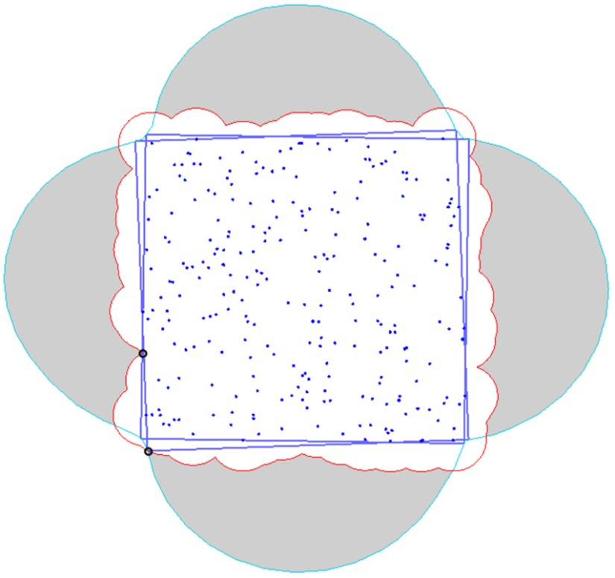
The rectangle problem with outliers
A generalization to k outliers is possible: we can choose how many points each side excludes
However, we are not completely fair: the outlier should not help to make the union of disks either This is much harder to handle efficiently

Slide 70
Outliers
In general, allowing many outliers can be handled
exactly, but the brute force approach is very slow
exactly, when the geometry helps to limit what points can be outliers
heuristically (ideally after studying the geometry), but this can easily miss the best solution (for example, incrementally removing outliers one by one)

Slide 71
Summary
In point pattern matching, we have complete matching or partial matching between two point sets, or complete or partial matching between a point set and a shape
We may need to deal with noise, especially in the case with two point sets
We may have to deal with outliers, especially in the case with complete matching

